Slide 1

Partial Fractions
Copyright © Cengage Learning. All rights reserved.

Slide 2
Objectives
Understand the concept of partial fraction decomposition.
Use partial fraction decomposition with linear factors to integrate rational functions.
Use partial fraction decomposition with quadratic factors to integrate rational functions.

Slide 3
Partial Fractions

Slide 4
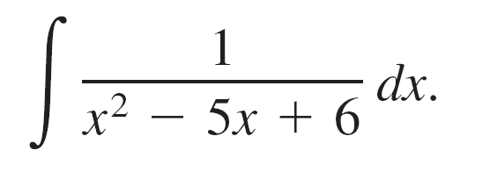
Partial Fractions
The method of partial fractions is a procedure for decomposing a rational function into simpler rational functions to which you can apply the basic integration formulas.
To see the benefit of the method of partial fractions, consider the integral

Slide 5
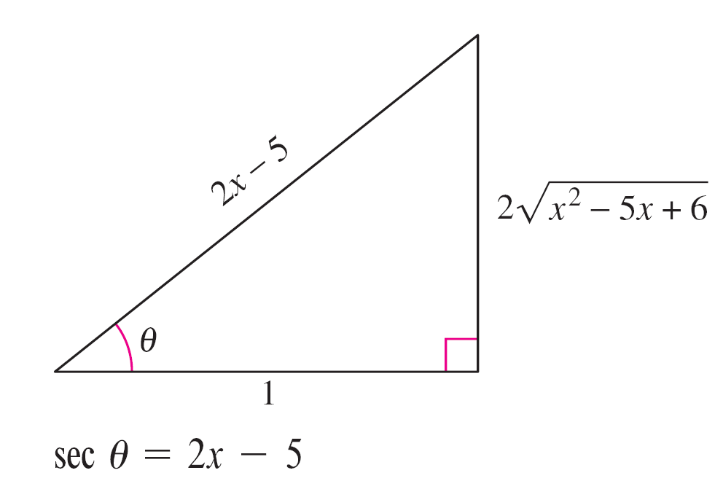
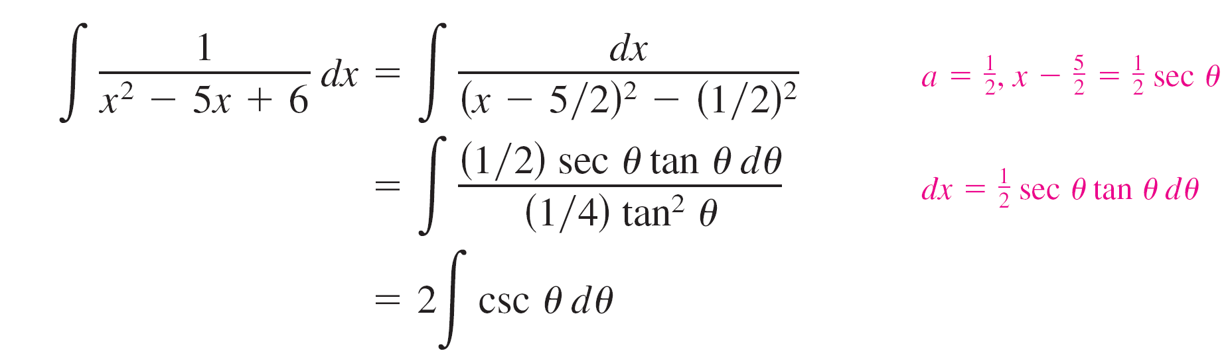
Partial Fractions
To evaluate this integral without
partial fractions, you can complete
the square and use trigonometric
substitution (see Figure 8.13) to
obtain
Figure 8.13

Slide 6
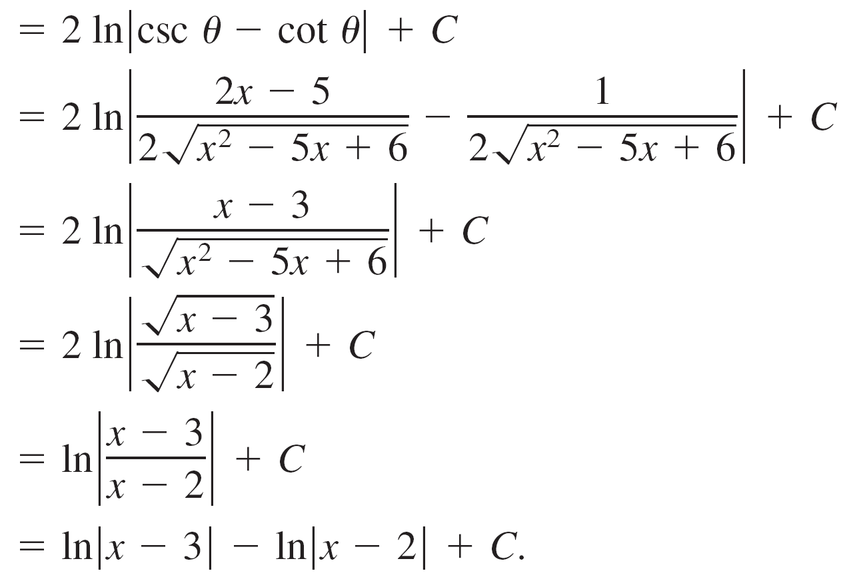
Partial Fractions

Slide 7
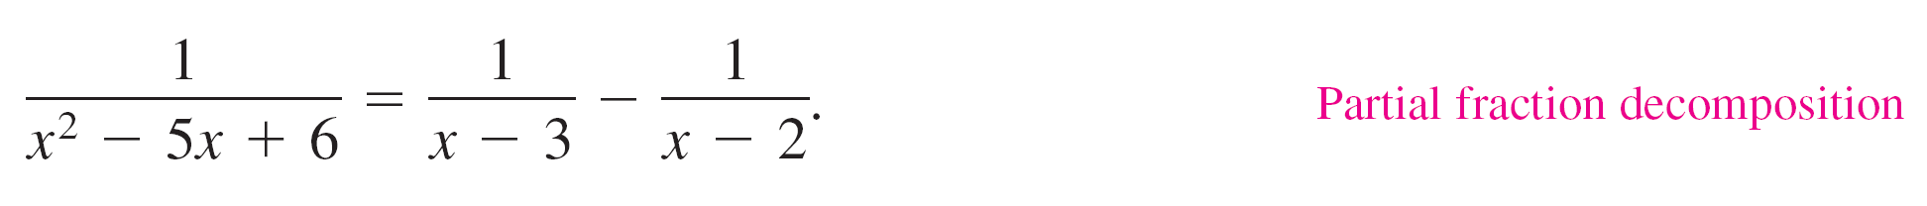
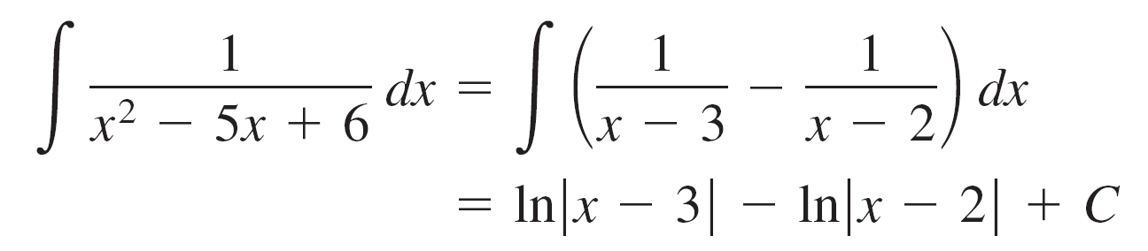
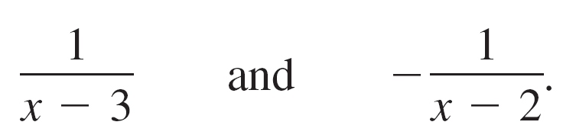
Partial Fractions
Now, suppose you had observed that
Then you could evaluate the integral easily, as follows.
This method is clearly preferable to trigonometric substitution. However, its use depends on the ability to factor the denominator, x² – 5x + 6, and to find the partial fractions

Slide 8

Partial Fractions
Recall from algebra that every polynomial with real coefficients can be factored into linear and irreducible quadratic factors.
For instance, the polynomial
can be written as

Slide 9


Partial Fractions
where (x – 1) is a linear factor, (x + 2)² is a repeated linear factor, and (x² + 1) is an irreducible quadratic factor.
Using this factorization, you can write the partial fraction decomposition of the rational expression
where N(x) is a polynomial of degree less than 5, as shown.

Slide 10
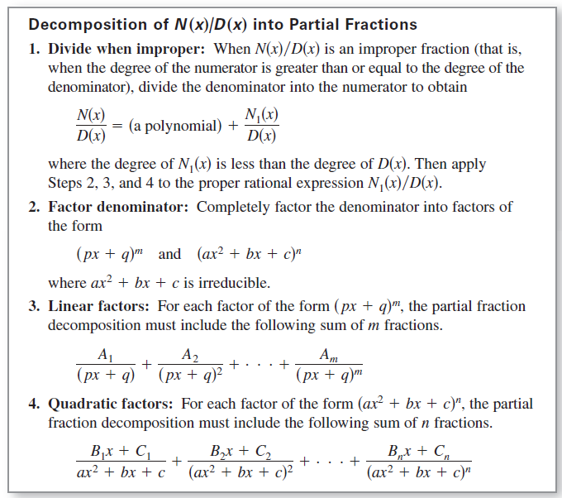
Partial Fractions

Slide 11
Linear Factors

Slide 12
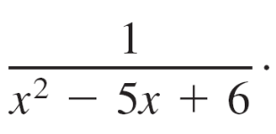
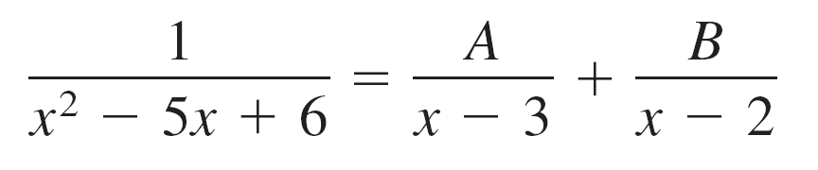
Example 1 – Distinct Linear Factors
Write the partial fraction decomposition for
Solution:
Because x² – 5x + 6 = (x – 3)(x – 2), you should include one partial fraction for each factor and write
where A and B are to be determined.
Multiplying this equation by the least common denominator (x – 3)(x – 2) yields the basic equation
1 = A(x – 2) + B(x – 3). Basic equation.

Slide 13
Example 1 – Solution
cont’d
Because this equation is to be true for all x, you can substitute any convenient values for x to obtain equations in A and B.
The most convenient values are the ones that make particular factors equal to 0.
To solve for A, let x = 3.
1 = A(3 – 2) + B(3 – 3) Let x = 3 in basic equation.
1 = A(1) + B(0)
1= A

Slide 14
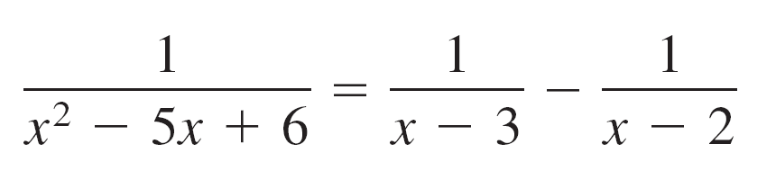
Example 1 – Solution
cont’d
To solve for B, let x = 2 and obtain
1 = A(2 – 2) + B(2 – 3) Let x = 2 in basic equation
1 = A(0) + B(–1)
-1 = B
So, the decomposition is
as shown at the beginning of this section.

Slide 15
Quadratic Factors

Slide 16
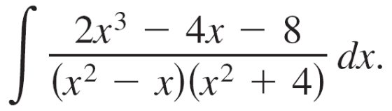
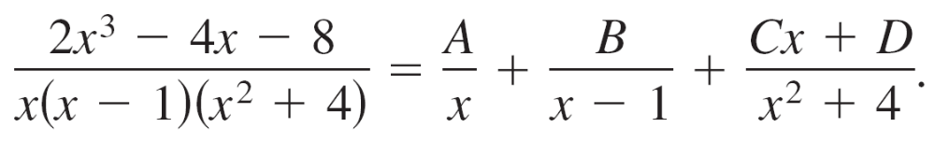
Example 3 – Distinct Linear and Quadratic Factors
Find
Solution:
Because (x² – x)(x² + 4) = x(x – 1)(x² + 4) you should include one partial fraction for each factor and write
Multiplying by the least common denominator x(x – 1)(x² + 4) yields the basic equation
2x³ – 4x – 8 = A(x – 1)(x² + 4) + Bx(x² + 4) + (Cx + D)(x)(x – 1).

Slide 17
Example 3 – Solution
cont’d
To solve for A, let x = 0 and obtain
–8 = A(–1)(4) + 0 + 0
2 = A
To solve for B, let x = 1 and obtain
–10 = 0 + B(5) + 0
–2 = B
At this point, C and D are yet to be determined. You can find these remaining constants by choosing two other values for x and solving the resulting system of linear equations.

Slide 18
Example 3 – Solution
cont’d
Using x = –1, then, A = 2 and B = –2, you can write
–6 = (2)(–2)(5) + (–2)(–1)(5) + (–C + D)(–1)(–2)
2 = –C + D
If x = 2, you have
0 = (2)(1)(8) + (–2)(2)(8) + (2C + D)(2)(1)
8 = 2C + D
Solving the linear system by subtracting the first equation from the second
–C + D = 2
2C + D = 8
yields C = 2

Slide 19
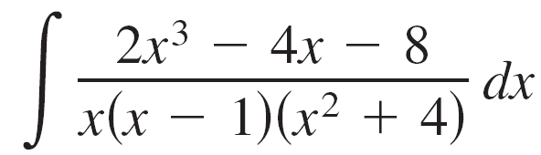
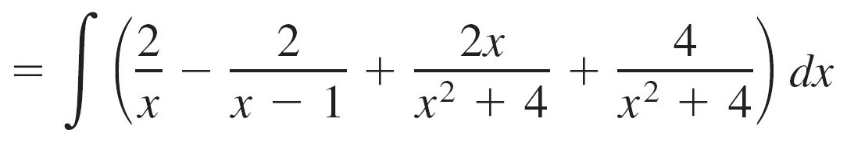
Example 3 – Solution
cont’d
Consequently, D = 4, and it follows that

Slide 20
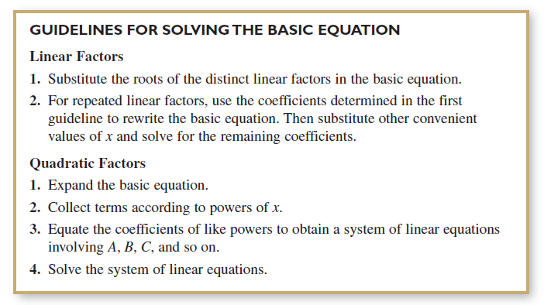
Quadratic Factors
Here are some guidelines for solving the basic equation that is obtained in a partial fraction decomposition.

